Slide 1

Chapter 4 Reproductive Health
Family Planning

Slide 2

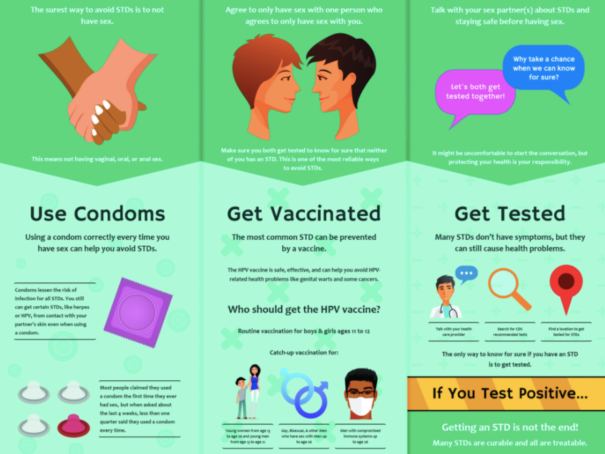


Why do we need to study human reproduction?
For awareness (sex education) about myths and misconception in schools about various reproduction related aspects like;
various family planning techniques
preventive methods against sexually transmitted diseases.
consequences of uncontrolled population growth
Various social evils (sex abuses, sex related crimes, use of drugs, female foeticide, tobacco and alcohol, child marriage, etc.).

Slide 3

What is Reproductive health?
Reproductive health refers to healthy reproductive organs with normal functions, including the emotional well being and healthy social aspects of reproduction
According to the World Health Organisation (WHO), reproductive health means;
A total well being in all aspects of reproduction, i.e., physical, emotional, behavioural and social.

Slide 4
How would you explain a reproductively healthy society?
A reproductively healthy society is a society with people having
physically and functionally normal reproductive organs and
normal emotional and behavioural interactions among them in all sex-related aspects
Sex Education

Slide 5

India’s mission to become reproductively healthy nation
Total reproductive health is a social goal for India like every nation.
India is the first country (1951) to initiate a nation wide Family Planning programmes.
Family Planning were periodically assessed over the past decades.
‘Family Planning’ includes action plans and programmes to attain total reproductive health, say, Reproductive and Child Health Care (RCH) programmes.
RCH programmes are Improved programmes covering reproduction related areas for building up reproductively healthy society.
https://humdo.nhp.gov.in/

Slide 6
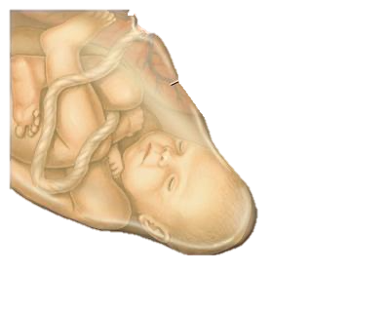
Reproductive and Child Health Care (RCH) programmes
Mass child immunisation
Statutory ban on amniocentesis*
To legally check increasing illegal female foeticides
Supports and encourage research on various reproduction related areas
*A foetal sex determination test based on the chromosomal pattern in the amniotic fluid (yellowish fluid) surrounding the developing embryo.
(This technique also helps to determine whether a foetus has genetic disorders)

Slide 7



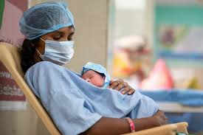
Major Tasks of RCH programmes;
Creating awareness among people about various reproduction related aspects
Providing facilities for building up a reproductively healthy society
To provide support for building up a reproductively healthy society

Slide 8
Indicators of improved reproductive health of a society
Better awareness about sex related matters
Increased number of medically assisted deliveries and
Better post-natal care
Decreased maternal mortality rates (MMR) and infant mortality rates (FMR)
Increased number of couples with small families,
Better detection and cure of STDs and
Overall increased medical facilities for all sex-related problems, etc.

Slide 9
AND BIRTH CONTROL
POPULATION EXPLOSION

Slide 10
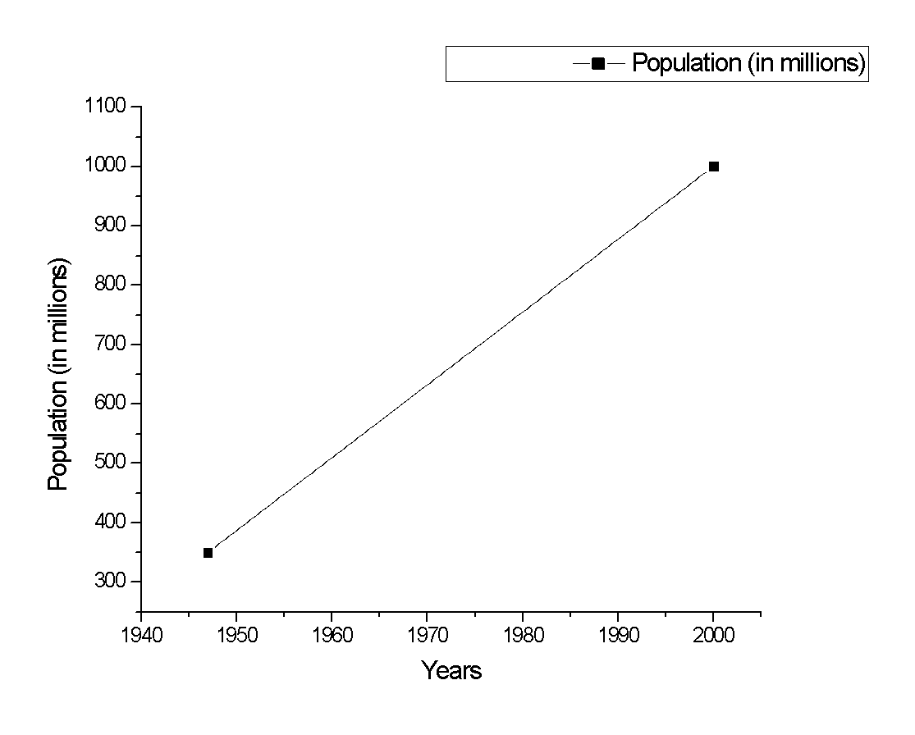
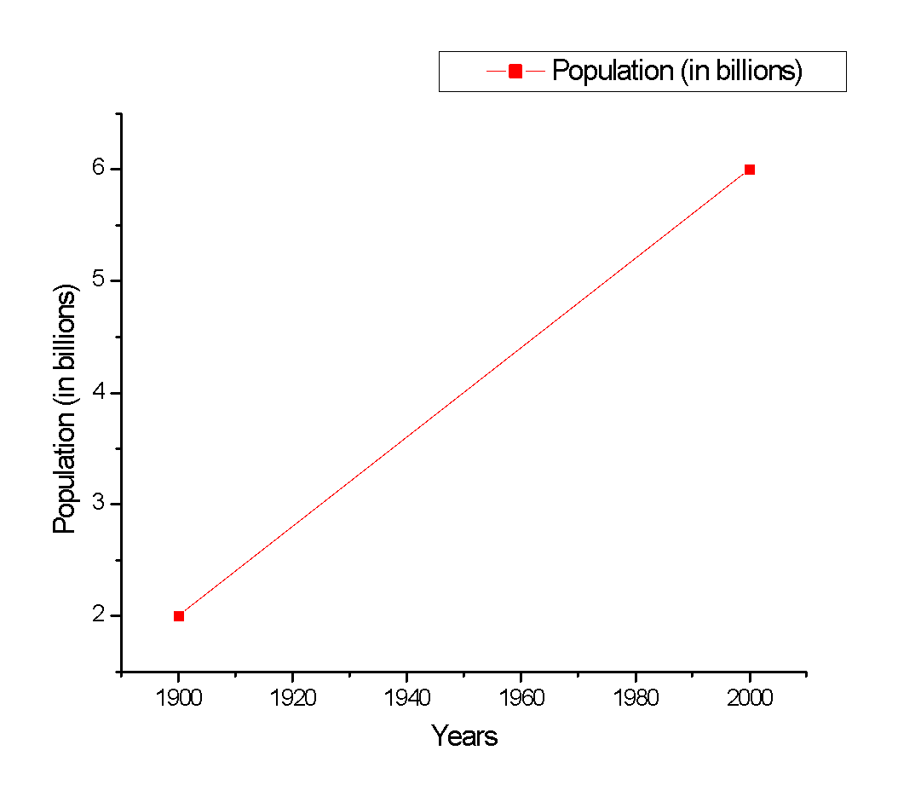
A statistical example of population explosion (A statistics given in NCERT Textbook)
2000, 6
2000, 1000
1900, 2
1947, 350
World population
Rapid population growth in India
2019 World population = 7.7 Billion
Current population of Inida = 1.3 Billion

Slide 11
What are the reasons for rapid population growth?
An all-round development in various fields (particularly the medical facilities) significantly improved the quality of life of the people (better living conditions).
A rapid decline in death rate, maternal mortality rate (MMR) and infant mortality rate (IMR)
Increase in number of people in reproducible age.

Slide 12
Do you think the alarming population growth rate is a problem? Why?
Alarming population growth lead to scarcity of the basic requirements, i.e., food, shelter and clothing,
Therefore, the government was forced to take up serious measures to check population growth rate.

Slide 13
Measures to check/tackle population growth rate
Motivating families to use various contraceptive methods. [
*Posters/bills showing a happy couple with two children with a slogan Hum Do Hamare Do (we two, our two)].
Ban on child marriage [by statutory raising of marriageable age of the female to 18 years and that of males to 21 years (The prohibition of child marriage act 2006)].
Giving incentives to couples with small families
Mandatory and free education for all children in India in the age group of 6 to 14 years as a Fundamental right.

Slide 14
Contraceptive methods
Contraceptive
is opposite of
conception

Slide 15
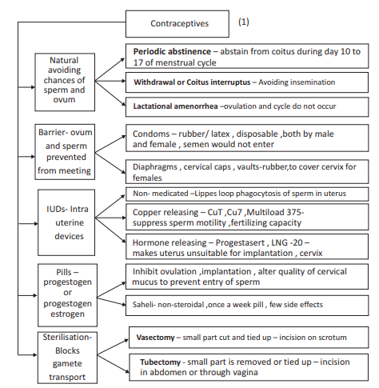

Slide 16
Contraceptive methods
Commonly used contraceptive methods help prevent unwanted pregnancies.
A wide range of contraceptive methods are presently available as listed below;
Natural/Traditional (As no medicines or devices are used),
Barrier,
Intra Uterine Devices (IUDs),
Oral contraceptives,
Injectables,
Implants and
Surgical methods.

Slide 17
An ideal contraceptive method should be
user-friendly,
Affordable,
easily available,
effective
reversible with no or least side-effects.
Shouldn’t interfere with the sexual drive, desire and/or the sexual act of the user.

Slide 18
Natural Contraceptive methods
Natural Contraceptive methods | Working principle (Avoiding chances of meeting ovum and sperms) | Effectiveness
Couples avoid or abstain from coitus during fertile period (i.e. from day 10 to 17 of the menstrual cycle when ovulation could be expected and there is high chances of fertilisation).
Periodic abstinence
_________________
As no medicines or devices are used in these methods, side effects are almost nil.
Withdrawal or
coitus interruptus
Male partner withdraws his penis from the vagina just before ejaculation so as to avoid insemination.
_________________
Lactational amenorrhea*
Method
*Absence of menstruation cycle during intense lactation
Menstrual cycle and ovulation do not occur during the period of intense lactation following parturition.
Therefore, as long as the mother breast-feeds the child fully, chances of conception are almost nil.
Effective only up to six months following parturition.
High chances of failure.

Slide 19
Barrier methods
Working principle
Ovum and sperms are prevented from physically meeting with the help of barriers.

Slide 20
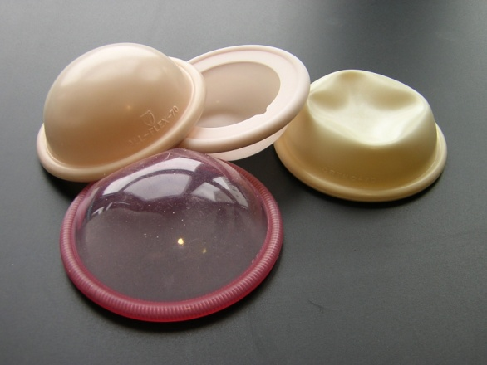
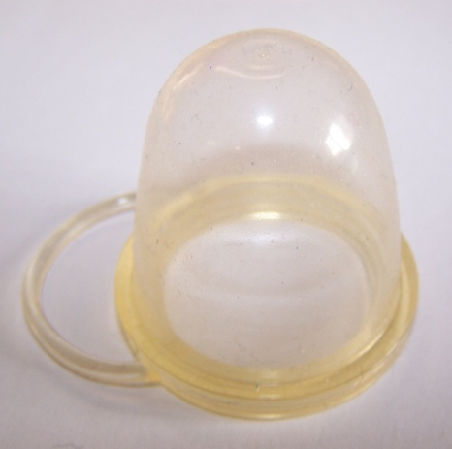
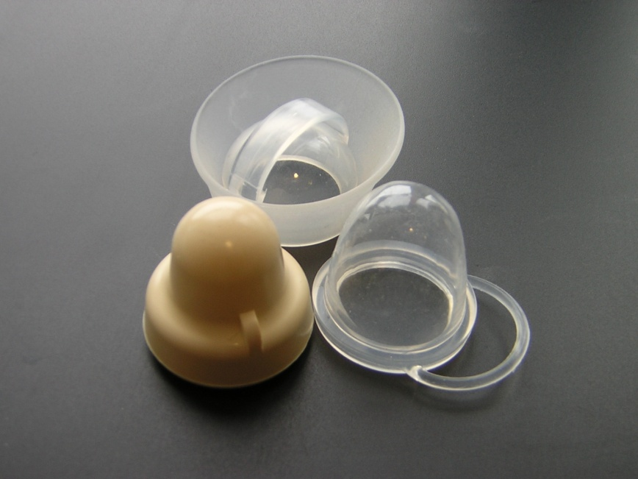

Condoms, diaphragms, cervical caps and vaults are used as barrier methods
Condoms are barriers made of thin rubber/latex
Used to cover the penis in the male or vagina and cervix in the female
Used just before coitus to avoid insemination i.e. stop the ejaculated semen from entering into the female reproductive tract.
Both the male and the female condoms are disposable
Usage of condom gives privacy to the user
Condom can prevent conception and pregnancy
Condom protects the user from contracting STDs like HIV
Diaphragms, cervical caps and vaults as barriers (made of rubber) that are used by female reproductive tract to cover the cervix during coitus.
These prevent conception by blocking the entry of sperms through the cervix.
There are Spermicidal creams, jellies and foams which are usually used along with these barriers to increase their contraceptive efficiency.
Diaphragms
Vaults
Cervical caps
Condoms

Slide 21
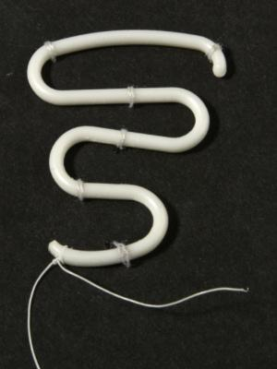
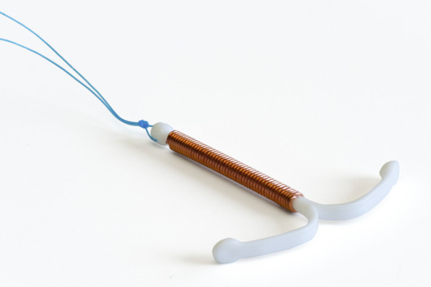
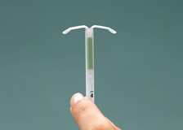
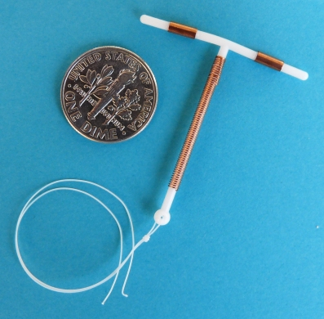
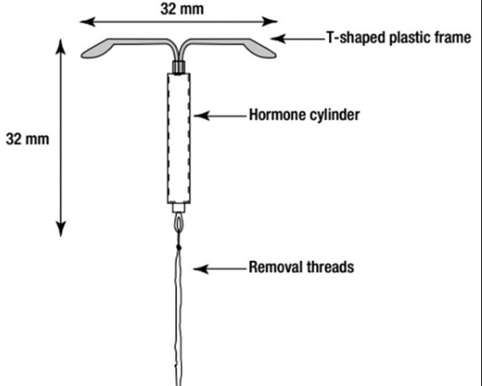
Intrauterine Devices (IUDs)
IUDs are most widely accepted methods of contraception in India.
IUDs devices are inserted by doctors or expert nurses in the uterus through vagina.
Intra Uterine Devices which are presently available are;
Non-medicated IUDs (e.g., Lippes loop),
Copper releasing IUDs (CuT, Cu7, Multiload 375)
Hormone releasing IUDs (Progestasert, LNG-20).
IUDs increase phagocytosis of sperms within the uterus
Copper (Cu) ions released suppress sperm motility and the fertilising capacity of sperms.
The hormone releasing IUDs make the uterus unsuitable for implantation and the cervix hostile to the sperms.
IUDs are ideal contraceptives for the females who want to delay pregnancy and/or space children.
Lippes loop
Progestasert
Copper releasing IUDs

Slide 22

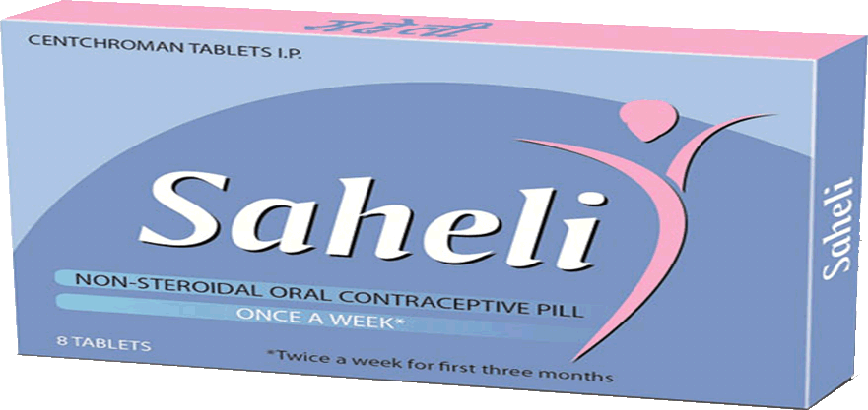
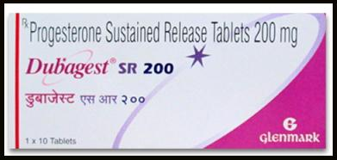
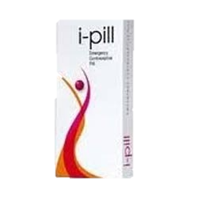

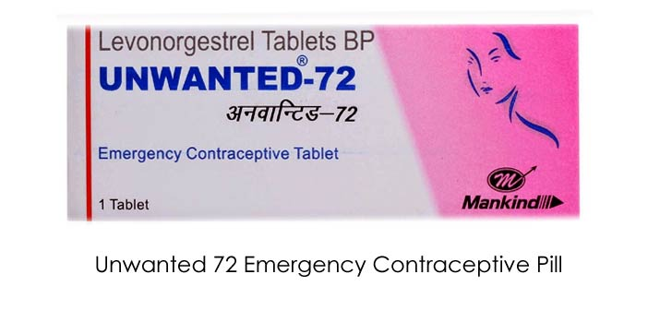

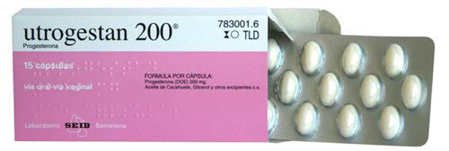
Oral contraceptives pills (Birth control pills)
Oral contraceptives pills/ tablets are well accepted by the females.
Oral administrated oral pills have small doses of either
Progestogens or
progestogen–estrogen combinations.
Prescription
Birth control pills have to be taken daily for a period of 21 days with a gap of 7 days (during which menstruation occurs)
Effectiveness of of oral contraceptives pills
Pills are very effective with lesser side effects.
inhibit ovulation and implantation.
alter the quality of cervical mucus to prevent/retard entry of sperms.
Notes:
Birth control pills prevent pregnancy through several mechanisms, mainly by stopping ovulation. If no egg is released, there is nothing to be fertilized by sperm, and the woman cannot get pregnant. Most birth control pills contain synthetic forms of two female hormones: estrogen and progestin. These synthetic hormones stabilize a woman's natural hormone levels, and prevent estrogen from peaking mid-cycle. Without the estrogen bump, the pituitary gland does not release other hormones that normally cause the ovaries to release mature eggs.
Specifically, synthetic estrogen in the pill works to:
Stop the pituitary gland from producing follicle stimulating hormone (FSH) and luteinizing hormone (LH) in order to prevent ovulation.
Support the uterine lining (endometrium) to prevent breakthrough bleeding mid-cycle.
Meanwhile, synthetic progestin works to:
Stop the pituitary gland from producing LH in order to prevent egg release.
Make the uterine lining inhospitable to a fertilized egg.
Partially limit the sperm's ability to fertilize the egg.
Thicken the cervical mucus to hinder sperm movement (although this effect may not be key to preventing pregnancy).
There are two kinds of hormonal birth control pills: (1) the combination pill which contains estrogen and progestin and (2) the progestin-only pill (known as the minipill). Combo pills are significantly more effective than progestin-only pills and have the added benefit of less breakthrough bleeding. However, some women cannot tolerate estrogen and prefer the progestin-only pill. Both types of pills are available in several different brands, each of which have slightly different blends of hormones.
These two kinds of hormonal birth control are available in other forms besides pills. The combination formula is also available as a patch and a vaginal ring. The progestin-only formula is also available in intramuscular shots (Depo-Provera), an implant (Implanon), and in intrauterine devices (the Mirena IUD).
Some women may prefer these other forms of hormonal birth control because they can be taken less often (and consequently are easier to remember). While birth control pills must be taken everyday, the patch is only applied once per week, the vaginal ring only once per month, and the intramuscular shot only once every three months. An IUD is inserted into the uterus and can prevent pregnancy for five years or more. In the US, hormonal birth control pills and devices are only available by prescription. Women may want to ask a gynecologist or women's health care provider for information about different kinds of birth control, including which methods would be best for them personally.
If you choose birth control pills (which are sometimes the cheapest form of birth control), it is very important to take the pills at the same time everyday. This creates a more stable level of hormones in your body. When you forget your pill (or take it three to four hours late or more), this causes a dip in your body's levels of the birth control hormones. If you forget your pill one day, you may need to take two pills the next day, which will cause a spike in your body's levels of the birth control hormones. To maximize protection against pregnancy and to minimize side effects, pick a time you are likely to remember (maybe first thing in the morning or right before bed) and take your pill this same time everyday.
Finally, birth control pills traditionally come in packs of 21 or 28 pills. Both types of packs contain 21 active pills. The seven extra pills in the 28-pill pack are placebo pills which are there to remind you to continue taking one pill everyday and to remind you when to begin the next pack. Whether you take placebo pills or simply wait seven days to start the next pack, the seven day break from hormones triggers monthly bleeding that mimics a woman's menstrual period. Women are still protected from pregnancy during this time as long as they have taken all the active pills consistently and correctly.

Slide 23
Saheli as an example of oral contraceptives /Birth control pills
Saheli
the oral contraceptive for the females
It is a ‘once a week’ pill
contains a non-steroidal preparation.
Has high contraceptive value
has very few side effects
Notes:
Birth control pills prevent pregnancy through several mechanisms, mainly by stopping ovulation. If no egg is released, there is nothing to be fertilized by sperm, and the woman cannot get pregnant. Most birth control pills contain synthetic forms of two female hormones: estrogen and progestin. These synthetic hormones stabilize a woman's natural hormone levels, and prevent estrogen from peaking mid-cycle. Without the estrogen bump, the pituitary gland does not release other hormones that normally cause the ovaries to release mature eggs.
Specifically, synthetic estrogen in the pill works to:
Stop the pituitary gland from producing follicle stimulating hormone (FSH) and luteinizing hormone (LH) in order to prevent ovulation.
Support the uterine lining (endometrium) to prevent breakthrough bleeding mid-cycle.
Meanwhile, synthetic progestin works to:
Stop the pituitary gland from producing LH in order to prevent egg release.
Make the uterine lining inhospitable to a fertilized egg.
Partially limit the sperm's ability to fertilize the egg.
Thicken the cervical mucus to hinder sperm movement (although this effect may not be key to preventing pregnancy).
There are two kinds of hormonal birth control pills: (1) the combination pill which contains estrogen and progestin and (2) the progestin-only pill (known as the minipill). Combo pills are significantly more effective than progestin-only pills and have the added benefit of less breakthrough bleeding. However, some women cannot tolerate estrogen and prefer the progestin-only pill. Both types of pills are available in several different brands, each of which have slightly different blends of hormones.
These two kinds of hormonal birth control are available in other forms besides pills. The combination formula is also available as a patch and a vaginal ring. The progestin-only formula is also available in intramuscular shots (Depo-Provera), an implant (Implanon), and in intrauterine devices (the Mirena IUD).
Some women may prefer these other forms of hormonal birth control because they can be taken less often (and consequently are easier to remember). While birth control pills must be taken everyday, the patch is only applied once per week, the vaginal ring only once per month, and the intramuscular shot only once every three months. An IUD is inserted into the uterus and can prevent pregnancy for five years or more. In the US, hormonal birth control pills and devices are only available by prescription. Women may want to ask a gynecologist or women's health care provider for information about different kinds of birth control, including which methods would be best for them personally.
If you choose birth control pills (which are sometimes the cheapest form of birth control), it is very important to take the pills at the same time everyday. This creates a more stable level of hormones in your body. When you forget your pill (or take it three to four hours late or more), this causes a dip in your body's levels of the birth control hormones. If you forget your pill one day, you may need to take two pills the next day, which will cause a spike in your body's levels of the birth control hormones. To maximize protection against pregnancy and to minimize side effects, pick a time you are likely to remember (maybe first thing in the morning or right before bed) and take your pill this same time everyday.
Finally, birth control pills traditionally come in packs of 21 or 28 pills. Both types of packs contain 21 active pills. The seven extra pills in the 28-pill pack are placebo pills which are there to remind you to continue taking one pill everyday and to remind you when to begin the next pack. Whether you take placebo pills or simply wait seven days to start the next pack, the seven day break from hormones triggers monthly bleeding that mimics a woman's menstrual period. Women are still protected from pregnancy during this time as long as they have taken all the active pills consistently and correctly.

Slide 24
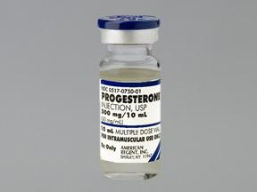
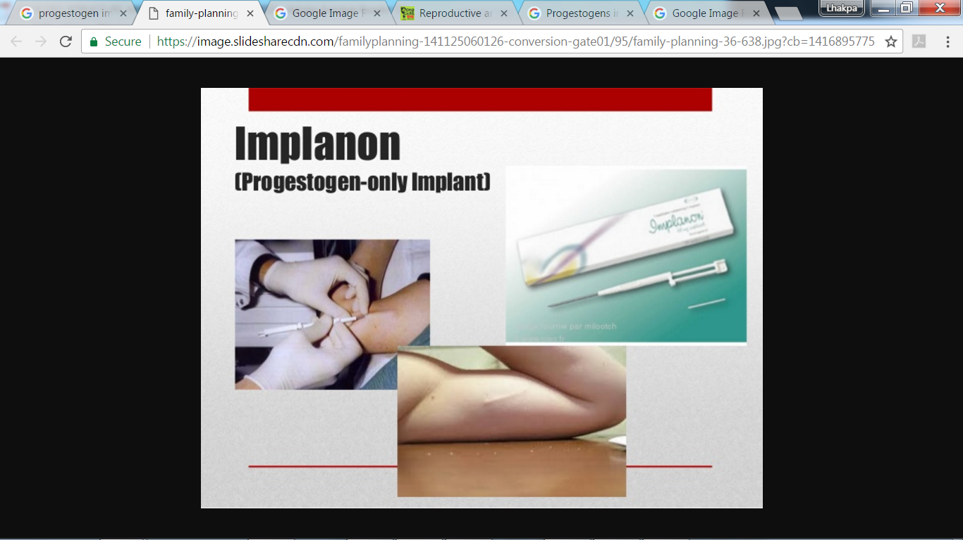
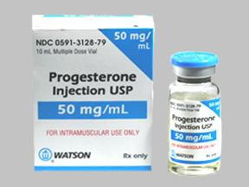

Injections and implants
Progestogens (progestins) alone or in combination with estrogen can also be used by females as injections or implants under the skin.
Their mode of action is similar to that of pills and their effective periods are much longer.

Slide 25
Effectiveness of contraceptives
Administration of progestogens or progestogen-estrogen combinations or IUDs within 72 hours of coitus have been found to be very effective as emergency contraceptives, as they could be used to avoid possible pregnancy due to rape or casual unprotected intercourse.

Slide 26
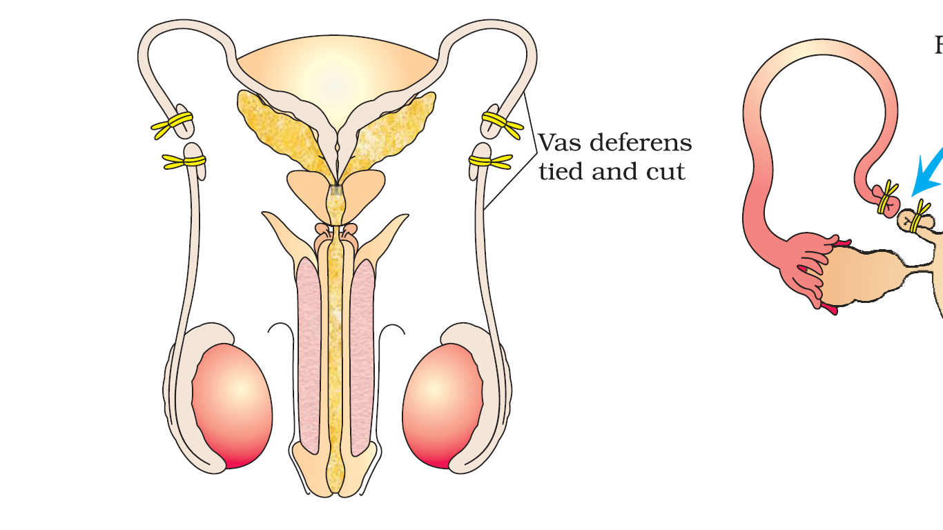
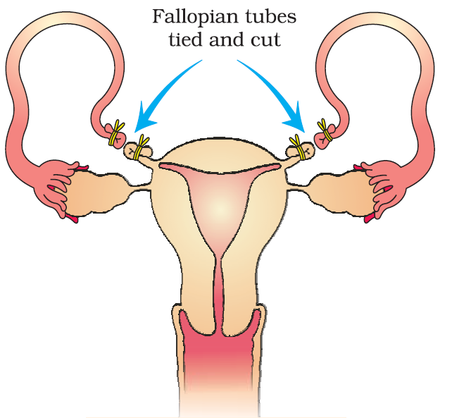
Surgical methods/sterilisation
Terminal method to prevent any more pregnancies.
Working Principle: Surgical intervention blocks gamete transport and thereby prevent conception.
Surgical methods are generally used for both the male and female partner
Sterilisation procedure in the male is called ‘vasectomy’
Sterilisation procedure in the female is called ‘tubectomy’
These techniques are highly effective but their reversibility is very poor.
Vasectomy(-ectomy: removal of)
A small part of the vas deferens is removed or tied up through a small incision on the scrotum
Tubectomy (-ectomy: removal of)
A small part of the fallopian tube is removed or tied up through a small incision in the abdomen or through vagina.

Slide 27
Things to remember before using contraceptive methods
Contraceptive methods are meant either to prevent pregnancy or to delay or space pregnancy due to personal reasons.
These are practiced against a natural reproductive event, i.e., conception/pregnancy.
Contraceptives are not regular requirements for the maintenance of reproductive health.

Slide 28
Selection and use of a suitable contraceptive method
The selection and use of a suitable contraceptive method should always be undertaken in consultation with qualified medical professionals.
Possible ill-effects induced by contraceptive methods may be nausea, abdominal pain, break through bleeding, irregular menstrual bleeding or breast cancer.
Side effects of use of contraceptives should not be totally ignored.
Contraceptive methods are not meant for pleasure. Hence, contraceptive methods should be used properly and wisely,

Slide 29
Home work
What is amniocentesis. Why does amniocentesis is banned in India?
How would you justify that a society has improved reproductive health?
Explain Lactational amenorrhea.
Discuss the types of intrauterine devices and their effectiveness to prevent pregnancy.
Saheli is an ideal oral contraceptives. Justify.
How vasectomy is different from tubectomy?
How effective are administration of progestogens or progestogen-estrogen combinations or IUDs?
Visit https://humdo.nhp.gov.in/ to know more about Family Planning

Slide 30

SEXUALLY TRANSMITTED DISEASES

Slide 31
Sexually Transmitted Diseases (STDs)
Diseases or infections which are transmitted through sexual intercourse are collectively called Sexually Transmitted Diseases (STD) or Venereal Diseases (VD) or Reproductive Tract Infections (RTI).
Some examples;
Genital herpes, genital warts, hepatitis-B, HIV leading to AIDS, gonorrhoea, syphilis, chlamydiasis, trichomoniasis, etc
Among these, HIV infection is considered most dangerous.

Slide 32
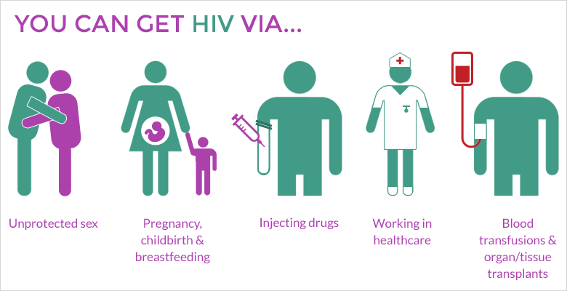
Mode of Transmission of HIV

Slide 33
Mode of Transmission of Hepatitis–B and HIV
Reproductive Tract Infections (RTI) | Mode of Transmission
HIV
Hepatitis–B
Sharing of injection needles, surgical instruments, etc., with infected persons,
transfusion of blood,
from an infected mother to the foetus too.

Slide 34
Sexually Transmitted Diseases (STDs)
Except for hepatitis-B, genital herpes and HIV infections, other diseases are completely curable if detected early and treated properly.
Early symptoms of most of minor STDs include
☞ Itching in genital region,
☞ Slight pain in genital region,
Swellings in genital region,
Fluid discharge from genital.
Infected individuals may often be asymptomatic and hence, may remain undetected for long.

Slide 35
SEXUALLY TRANSMITTED DISEASES (STDs)
Factors that deter the infected persons from going for timely detection and proper treatment are;
Absence or less significant symptoms in the early stages of infection and
the social stigma associated with STDs,
Complications of chronic STDs;
Infertility
Pelvic inflammatory diseases (PID)
Still births [Birth of a baby who is born without any signs of life at or after 24 weeks of pregnancy. A baby may have died during late pregnancy (called intrauterine death)],
Ectopic pregnancies (also called eccyesis or tubal pregnancy, is a complication of pregnancy in which the embryo attaches outside the uterus in the fallopian tube. It lead to abdominal pain and vaginal bleeding)
Abortions
Cancer of the reproductive tract.

Slide 36

Sexually Transmitted Diseases (STDs)
Question: Do you think STDs are major threat to a healthy society?
Answer: Yes, STDs are a major threat to a healthy society. Therefore, early prevention and detection, and cure of STDs are given prime consideration under the reproductive health-care programmes.
Question: Which age groups are vulnerable to STDs?
Answer: Though all persons are vulnerable to STDs, their incidences are reported to be very high among persons in the age group of 15-24 year.

Slide 37
Some principles for prevention of Sexually Transmitted Diseases (STDs)
STDs can be prevented by following some simple principles like:
Avoid sex with unknown partners/multiple partners.
Always use condoms during coitus.
In case of doubt, go to a qualified doctor for early detection
Get complete treatment if diagnosed with disease.

Slide 38
MEDICAL TERMINATION OF PREGNANCY (MTP)

Slide 39
A fictional story to learn term Medical Termination Of Pregnancy (MTP)
Once upon a time, there lived a HIV-AIDS infected couple. They never wanted a baby. But, improper use of contraceptive method leads to conception of a baby boy. The lady didn’t know that she is pregnant until the first month of her pregnancy. Now, the couple want to terminate the baby intentionally.
Eventually, they could successfully undertake legally permitted medical termination of pregnancy (MTP) with the help of medical professionals in hospital and lived happily
Intentional or voluntary termination of pregnancy before full term is called medical termination of pregnancy (MTP) or induced abortion.

Slide 40

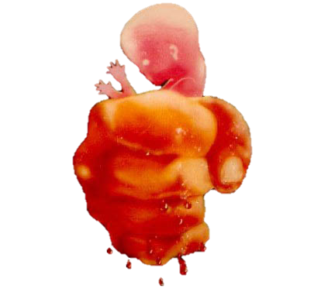
Medical Termination Of Pregnancy (MTP)
Nearly 45 to 50 million MTPs are performed in a year all over the world which accounts to 1/5th of the total number of conceived pregnancies in a year.
Acceptance and legalisation of MTP is being debated in many countries due to emotional, ethical, religious and social issues involved in it.
Government of India legalised MTP in 1971 with some strict conditions to avoid its misuse.
Governmental restrictions are to check indiscriminate and illegal female foeticides which are reported to be high in India.
MTP decreases population though it is not meant for that purpose.

Slide 41
Why Medical Termination Of Pregnancy (MTP)?
To get rid of unwanted pregnancies either due to
casual unprotected intercourse or
failure of the contraceptive used during coitus or
Rape case.
In certain cases where continuation of the pregnancy could be harmful or even fatal either to the mother or to the foetus or both.

Slide 42
Safeness of Medical Termination Of Pregnancy (MTP)
MTPs are considered relatively safe during the first trimester, i.e., up to 12 weeks of pregnancy.
Second trimester abortions are much more riskier.
Unhealthy, disturbing and dangerous trends;
☞ Unsafe and fatal MTPs performed illegally by unqualified quacks.
☞MTP of female foetus after determining sex of the unborn child by amniocentesis -a totally an illegal procedure.
These practices should be avoided because these are dangerous both for the young mother and the foetus.

Slide 43
Solution for avoiding unhealthy disturbing and dangerous MTP could be;
Providing effective counselling on
the need to avoid unprotected coitus
the risk factors involved in illegal abortions
Providing more health care facilities

Slide 44

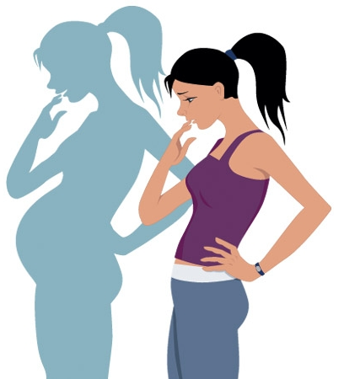


Infertility

Slide 45
Infertility (Inability to reproduce children)
A large number of couples all over the world including India are infertile, i.e., they are unable to produce children in spite of unprotected sexual co-habitation.
What do you think are the reasons for infertility?
Answer: The reasons for infertility could be;
Congenital (Birth defect or anomaly present at birth but not necessarily hereditary; acquired during foetal development),
Diseases,
Drugs,
Physical,
Immunological
Psychological.

Slide 46
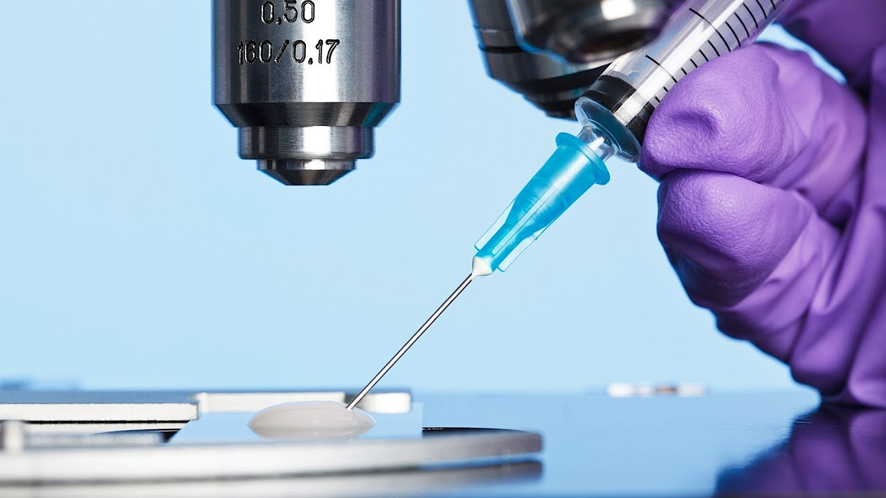
Infertility
Infertility may be due to problems in either of female or male partner of the couple.
In India, often the female is blamed for the couple being childless even if the problem lies in the male partner.
Specialised health care units (infertility clinics) could help in diagnosis and corrective treatment of some of these disorders and enable these couples to have children.
Corrections of infertility is may not be possible.
Infertile couple could be assisted to have children through certain special techniques commonly known as Assisted Reproductive Technologies (ART).

Slide 47
List of Assisted Reproductive Technologies (ART)
In vitro fertilisation (IVF)
ZIFT–Zygote Intra Fallopian Transfer
IUT – Intra Uterine Transfer
Intra Cytoplasmic Sperm Injection (ICSI)
Artificial Insemination (AI) technique
GIFT – Gamete Intra Fallopian Transfer

Slide 48
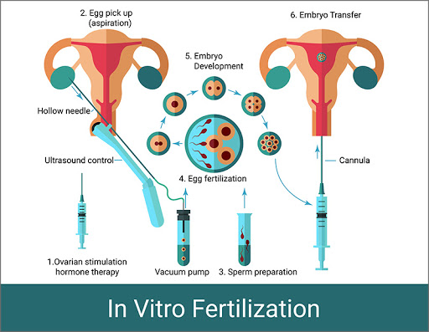
In vitro fertilisation/Test tube baby programme
In vitro fertilisation (IVF) (fertilisation outside the body in almost similar conditions as that in the body) followed by embryo transfer (ET).
In this method,
ova from the wife/donor (female) and sperms from the husband/donor (male) are collected and are induced to form zygote under simulated conditions in the laboratory.
The zygote or early embryos could then be transferred to complete its further development into
the fallopian tube with with up to 8 blastomeres (ZIFT–Zygote Intra Fallopian Transfer) or
embryos with more than 8 blastomeres, into the uterus (IUT – Intra Uterine Transfer).

Slide 49
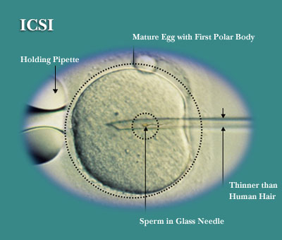
Intra Cytoplasmic Sperm Injection (ICSI)
Intra Cytoplasmic Sperm Injection (ICSI) is a specialised procedure to form an embryo in the laboratory in which a sperm is directly injected into the ovum.

Slide 50
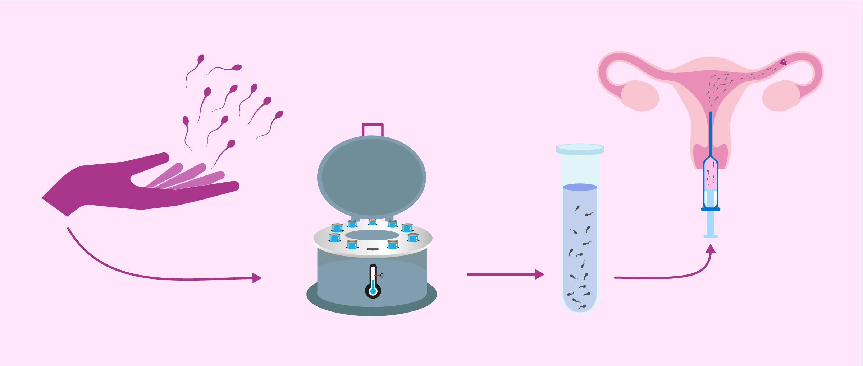
Artificial Insemination (AI) technique
Infertility cases either due to
inability of the male partner to inseminate the female
very low sperm counts in the ejaculates
These could be corrected by Artificial Insemination (AI) technique.
In Artificial Insemination (AI) technique, the semen collected either from the husband or a healthy donor is artificially introduced either into the vagina or into the uterus (IUI –Intra-uterine Insemination) of the female.
Embryos formed by in-vivo fertilisation could be used for artificial insemination to assist those females who cannot conceive.

Slide 51
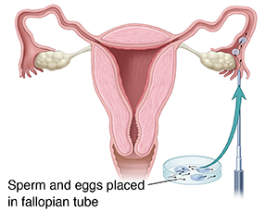
GIFT – Gamete Intra Fallopian Transfer
Transfer of an ovum collected from a donor into the fallopian tube (GIFT – Gamete Intra Fallopian Transfer) of another female who cannot produce ovum, but can provide suitable environment for fertilisation and further development.

Slide 52
Social issues related to infertility
Infertility correction techniques require
extremely high precision handling by specialised professionals and
expensive instrumentation.
These facilities are presently available only in very few centres in India.
These benefits are affordable to only a limited number of people.
Deterrents in the adoption of those infertility correction methods;
Emotional,
Religious and
Social Factors
As the ultimate aim of all ART procedures is to have children, the best methods for couples looking for parenthood legal adoption orphaned and destitute children as (Laws permit legal adoption)

Slide 53
Chapter 4 Reproductive Health
ends here…..

